Slide 1
Software Modeling
Jerry Lebowitz

Slide 2
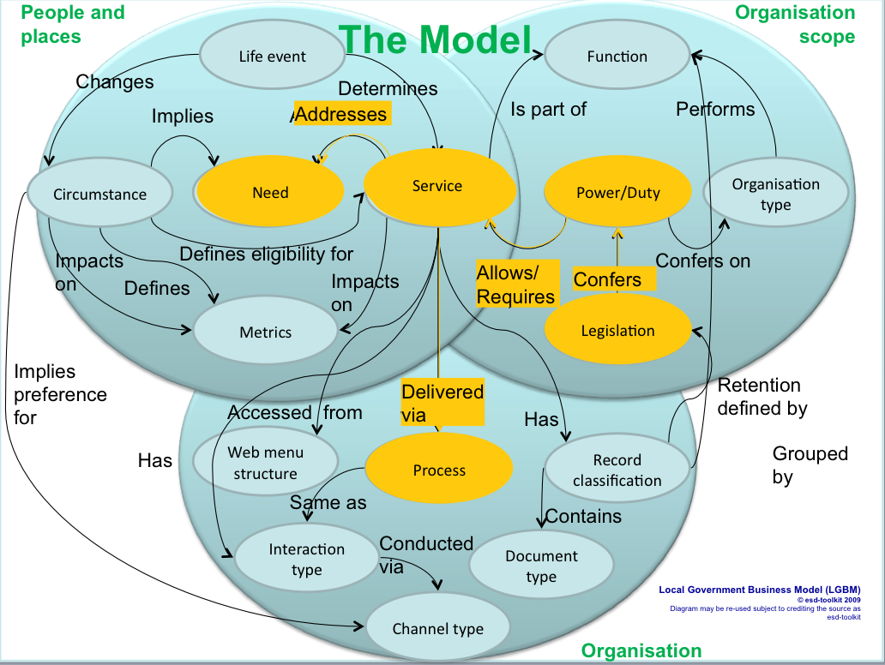
Software Modeling

Slide 3
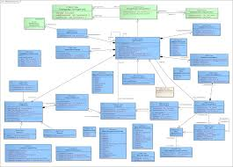
Topics
Why software models?
Unified modeling language (UML)
UML structure diagrams
Class diagrams
UML behavior diagrams
State diagrams
Interaction diagrams
Use cases
Activity diagrams

Slide 4
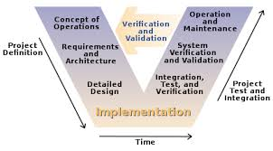
Why Models
Models help one understand and shape both the problem and the solution
It is a simplification of a complex system

Slide 5
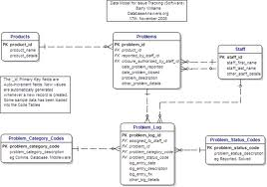
Unified Modeling Language (UML)
UML is a graphical language for visualizing, specifying, constructing and documenting the artifacts of an object-oriented software intensive system
Standards based
UML is a common language to express models
It does not tell one how to develop software

Slide 6
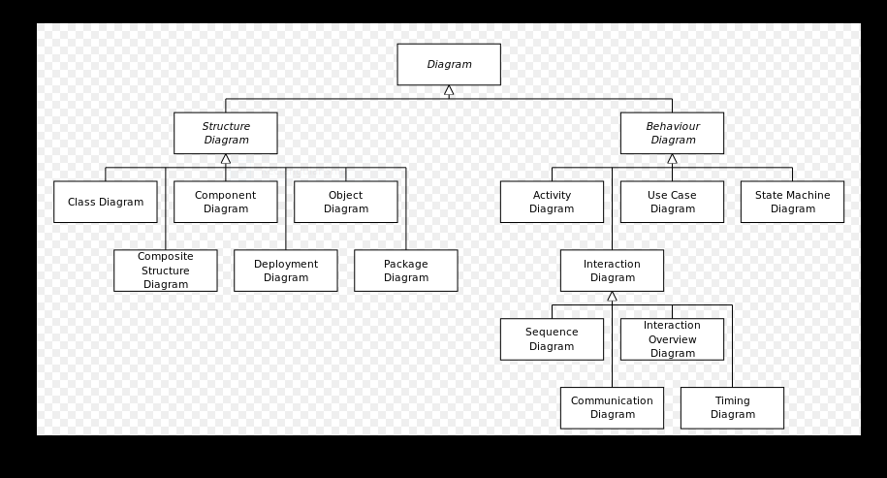
Unified Modeling Language (UML) Diagrams
State diagram

Slide 7
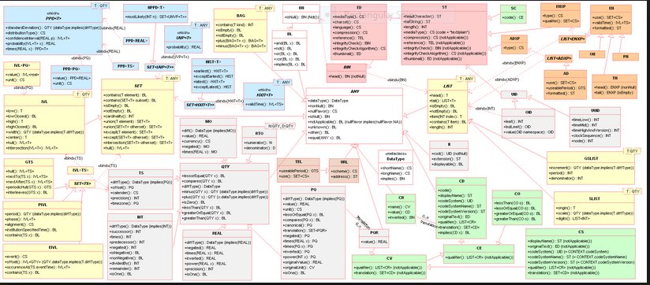
UML Overview

Slide 8
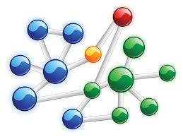
Structure Diagrams
Emphasize the things that must be present in the system being modeled
Since structure diagrams represent the structure, they are used extensively in documenting the software architecture of software systems
For example, the component diagram which describes how a software system is split up into components and shows the dependencies among these components

Slide 9

Behavior Diagrams
Emphasize what must happen in the system being modeled
Since behavior diagrams illustrate the behavior of a system, they are used extensively to describe the functionality of software systems
As an example, the activity diagram describes the business and operational step-by-step activities of the components in a system

Slide 10

Interaction Diagrams
Emphasize the flow of control and data among the things in the system being modeled
For example, the sequence diagram which shows how objects communicate with each other in terms of a sequence of messages
Interaction diagrams are a subset of behavior diagrams

Slide 11
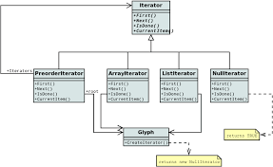
UML Structure Diagrams

Slide 12
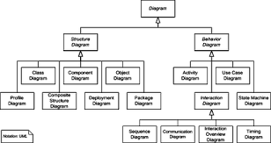
UML Structure Diagrams (1)
Structure diagrams emphasize the things that must be present in the system being modeled
Class diagram: describes the structure of a system by showing the system's classes, their attributes, and the relationships among the classes
Component diagram: describes how a software system is split up into components and shows the dependencies among these components
Composite structure diagram: describes the internal structure of a class and the collaborations that this structure makes possible

Slide 13
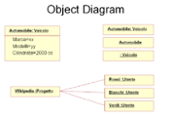
UML Structure Diagrams (2)
Deployment diagram: describes the hardware used in system implementations and the execution environments and artifacts deployed on the hardware
Object diagram: shows a complete or partial view of the structure of an example modeled system at a specific time

Slide 14
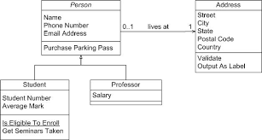
Class Diagrams

Slide 15
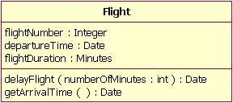
Class Diagrams
Are the main building blocks of object oriented modeling
Used for data modeling
Classes are represented with boxes which contain three parts
The top part contains the name of the class
The middle part contains the attributes of the class
The bottom part gives the methods or operations the class can take or undertake

Slide 16
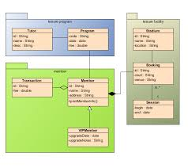
Class Diagrams
System designers use class diagrams as a way of simplifying how objects in a system interact with each other
Using class diagrams, it is easier to describe all the classes, packages, and interfaces that constitute a system and how these components are interrelated

Slide 17

Class Diagram Visibility Symbology
Used with methods and attributes
"+" Public
"-" Private
"#" Protected
"/" Derived (can be combined with one of the other symbols)
"_" Static

Slide 18
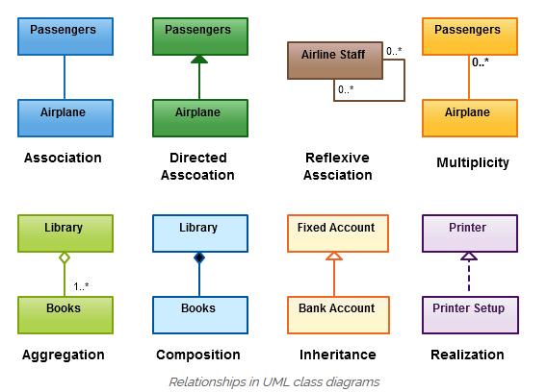
Class Relationships

Slide 19
Class Relationships
Inheritance
Composition
Aggregation
Association
Directed Association
Reflexive Association
Multiplicity
Realization

Slide 20
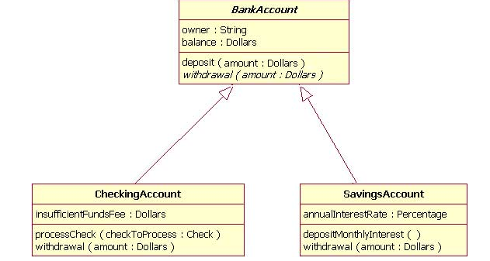
Relationships - Inheritance
Indicated by a solid line with a closed, unfilled arrowhead pointing at the super class (is a)

Slide 21
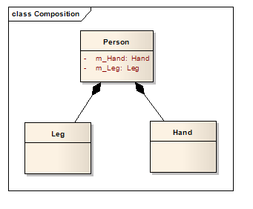
Relationships - Composition
Draw a solid line from the parent class to the “part of” class, and draw an filled diamond shape on the parent class's association end

Slide 22
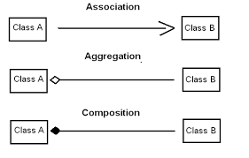
Relationships - Composition
Usually has a strong lifecycle dependency between instances of the container class and instances of the contained class(es)
If the container is destroyed, normally every instance that it contains is destroyed as well
Representation of a composition relationship is a filled diamond shape on the containing class end of the tree of lines that connect contained class(es) to the containing class

Slide 23
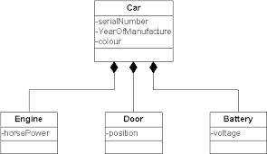
Relationships - Composition

Slide 24
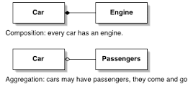
Relationships – Aggregation (1)
Occurs when a class is a collection or container of other classes, but the contained classes do not have a strong lifecycle dependency on the container (has a relationship)
The contents of the container are not automatically destroyed when the container is destroyed
Represented as a hollow diamond shape on the containing class with a single line that connects it to the contained class

Slide 25
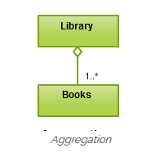
Relationships – Aggregation (2)
Refers to the formation of a particular class as a result of one class being aggregated or built as a collection
For example, the class “library” is made up of one or more books, among other materials. In aggregation, the contained classes are not strongly dependent on the life cycle of the container
In the same example, books will remain so even when the library is dissolved
To render aggregation in a diagram, draw a line from the parent class to the child class with a diamond shape near the parent class

Slide 26
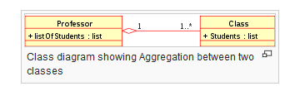
Relationships - Aggregation

Slide 27
Differences Between Composition and Aggregation
Composition relationship
An engine is a part of a car
Aggregation relationship
Car model engine ENG01 is part of a car model CM01, as the engine, ENG01 may be also part of a different car model
An aggregation relationship is often "catalog" containment to distinguish it from composition's "physical" containment

Slide 28
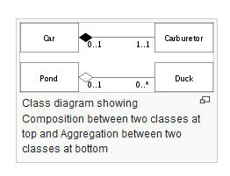
Composition vs. Aggregation

Slide 29
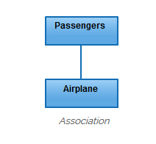
Relationships - Association
Is a broad term that encompasses just about any logical connection or relationship between classes
Simply states that there is some kind of a link or a dependency between two classes or more
For example, passenger and airline may be linked as below

Slide 30
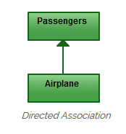
Directed Association
Refers to a directional relationship represented by a line with an arrowhead
The arrowhead depicts a container-contained directional flow

Slide 31
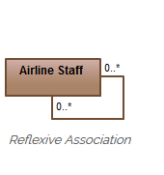

Reflexive Association
A reflexive association is an association from a class to itself
Can occur when a class has multiple functions or responsibilities
For example, a staff working in an airport may be a pilot, aviation engineer, a ticket dispatcher, a guard, or a maintenance crew member
If the maintenance crew member is managed by the aviation engineer there could be a managed by relationship in two instances of the same class

Slide 32

More on Association
Represents a family of links
A binary association (with two ends) is normally represented as a line
An association with three links is called a ternary association
Can link any number of classes
Can be named, and the ends of an association state role names, ownership indicators, multiplicity, visibility, and other properties

Slide 33


Association Example
Many to Many Relationship

Slide 34
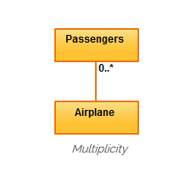
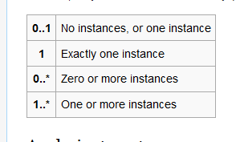
Multiplicity
Is an association when the cardinality of a class in relation to another is being depicted
For example, one fleet may include multiple airplanes, while one commercial airplane may contain zero to many passengers
The notation 0..* in the diagram means “zero to many

Slide 35
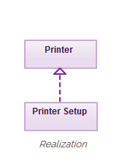
Realization
Denotes the implementation of the functionality defined in one class by another class (abstract)
A broken line with an unfilled solid arrowhead is drawn from the class that defines the functionality to the class that implements the function
For example, the printing preferences that are set using the printer setup interface can be implemented by the printer

Slide 36
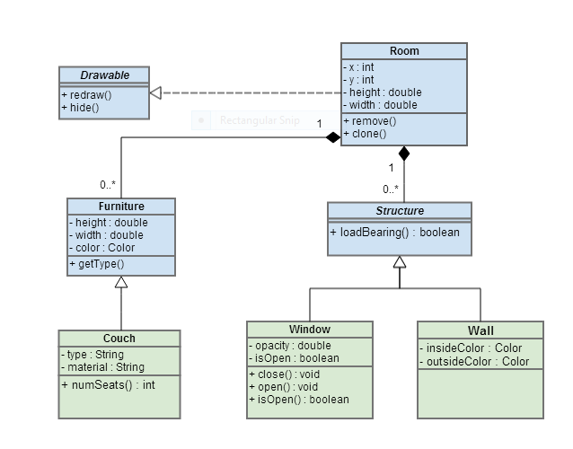
Class Diagram Example

Slide 37
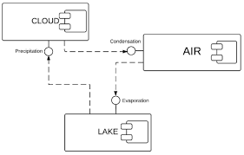
Component Diagrams

Slide 38
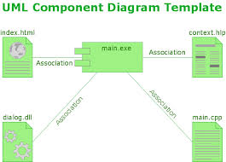
Component Diagrams (1)
Component diagrams depict how components are joined together to form larger components and or software systems
Components are project and implementation specific

Slide 39

Component Diagrams (2)
A component is a modular unit that is replaceable within its environment
Its internals are hidden, but it has one or more well-defined provided interfaces through which its functions can be accessed

Slide 40
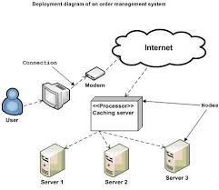
Component Diagrams (3)
A component can also have required interfaces
A required interface defines what functions or services it requires from other components
By connecting the provided and required interfaces of several components, a larger component can be constructed

Slide 41
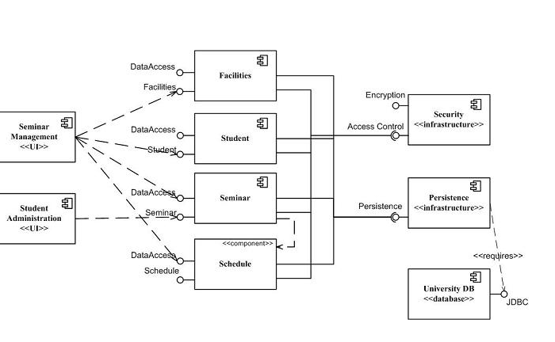
Component Diagram Example

Slide 42

Object Diagrams

Slide 43
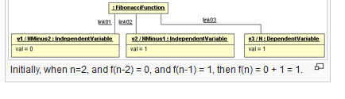
Object Diagrams
Focuses on some particular set of objects and attributes, and the links between these instances
Object diagrams and class diagrams are closely related and use almost identical notation
The use of object diagrams is fairly limited

Slide 44

Behavior Diagrams

Slide 45

UML Behavior Diagrams (1)
Emphasize what must happen in the system being modeled:
Activity diagram
Describes the business and operational step-by-step workflows of components in a system
An activity diagram shows the overall flow of control
UML state machine diagram
Describes the states and state transitions of the system

Slide 46
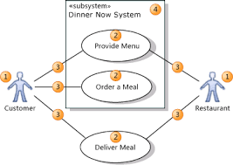
UML Behavior Diagrams (2)
Use case diagram
Describes the functionality provided by a system in terms of actors, their goals represented as use cases, and any dependencies among those use cases

Slide 47
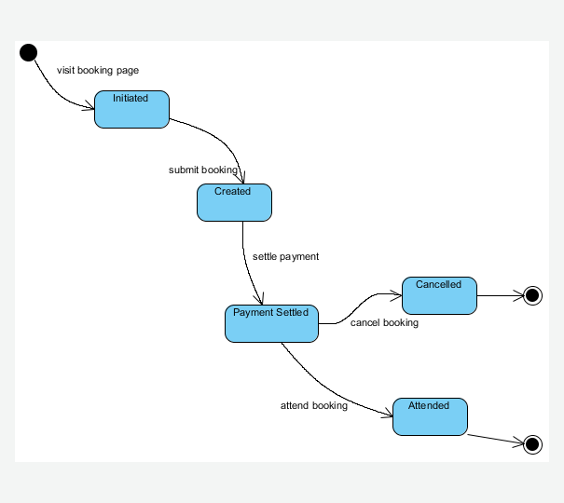
UML State Diagram
Directed graphs in which nodes denote states and connectors denote state transitions
.

Slide 48
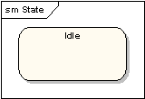
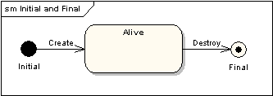
State Diagram (1)
A state is denoted by a round-cornered rectangle with the name of the state written inside it
Initial and final states
The initial state is denoted by a filled black circle and may be labeled with a name
The final state is denoted by a circle with a dot inside and may also be labeled with a name

Slide 49

State Diagram (2)
Transitions
Transitions from one state to the next are denoted by lines with arrowheads

Slide 50

State Diagram (3)
A transition may be a trigger, a guard and an effect
"Trigger" is the cause of the transition, which could be a signal, an event, a change in some condition, or the passage of time
"Guard" is a condition which must be true in order for the trigger to cause the transition
"Effect" is an action which will be invoked directly on the object that owns the state machine as a result of the transition

Slide 51
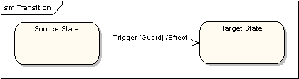
State Diagram Transition Example

Slide 52
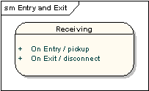
State Diagram
The diagram below shows a state with an entry action and an exit action

Slide 53
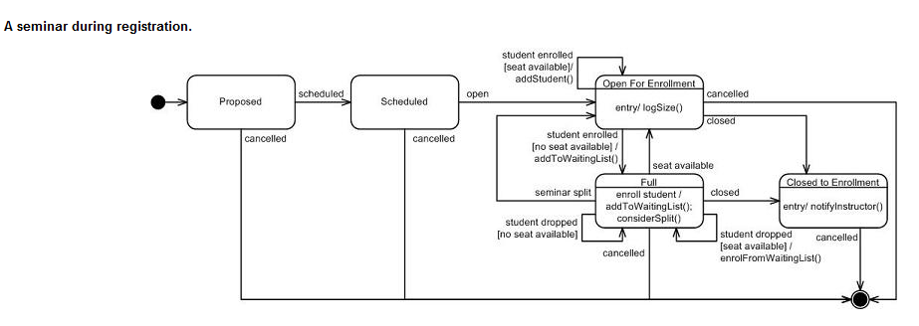
Example State Diagram

Slide 54
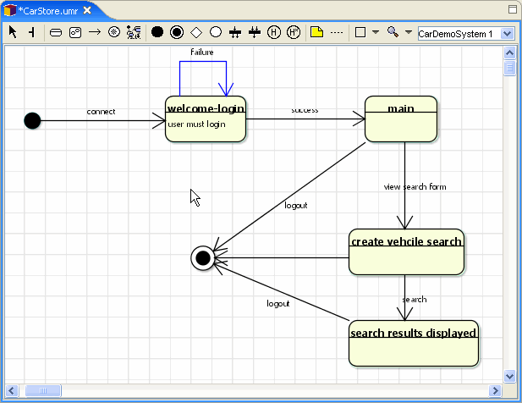
Another State Diagram

Slide 55

Interaction Diagrams

Slide 56

Interaction Diagrams (1)
Emphasize the flow of control and data among the things in the system being modeled:
Communication diagram
Shows the interactions between objects or parts in terms of sequenced messages
They represent a combination of information taken from Class
Use Case Diagrams
Describes both the static structure and dynamic behavior of a system

Slide 57
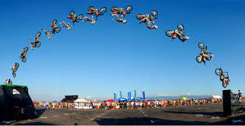
Interaction Diagrams (2)
Interaction overview diagram
Provides an overview in which the nodes represent communication diagrams
Sequence diagram
Shows how objects communicate with each other in terms of a sequence of messages
Also indicates the lifespan of objects relative to those messages

Slide 58

Interaction Diagrams (3)
Timing diagrams
A specific type of interaction diagram where the focus is on timing constraints

Slide 59
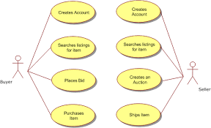
Use Cases

Slide 60
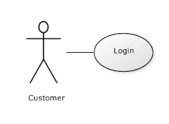
Use Case Definitions (1)
Use case
A sequence of actions a system performs that yields an observable result of value to an actor or actors
Iterative and evolutionary nature
Good fit for agile development
A solution can be expressed as a set of use cases
Derived from system requirements

Slide 61
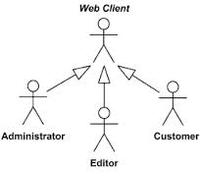
Use Case Definitions (2)
Actor
Someone or something outside the system that interacts with the system

Slide 62

Use Case Definitions (3)
Actions
A computational or algorithmic procedure that is invoked when an actor provides a signal to the system or when the system gets a time event
The execution of an action represents some transformation or processing in the system

Slide 63
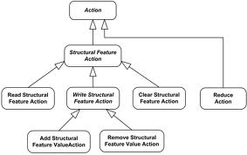
Use Case Definitions (4)
A sequence of actions
Specific flow of events through the system

Slide 64
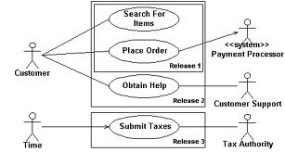
Use Case Definitions (5)
An observable result of value
The sequence of actions must yield something that has value to an actor of the system
An actor should not have to perform multiple use cases to achieve something useful

Slide 65

Sunny Day Use Cases
Use cases that are most likely going to occur when all goes well

Slide 66

Raining Day Use Cases
Use cases that are most likely going to occur when do not go well

Slide 67
Use Case Development
Identify the key components of your use cases
Textual representation illustrating a sequence of events
Use Case Number | ID to represent your use case
Application | What system or application does this pertain to
Use Case Name | The name of your use case, keep it short and sweet
Use Case Description | Elaborate more on the name, in paragraph form.
Primary Actor | Who is the main actor that this use case represents
Precondition | What preconditions must be met before this use case can start
Trigger | What event triggers this use case
Basic Flow | The basic flow should be the events of the use case when everything is perfect; there are no errors, no exceptions. This is the "sunny day scenario". The exceptions will be handled in the "Alternate Flows" section.
Alternate Flows | The most significant alternatives and exceptions

Slide 68
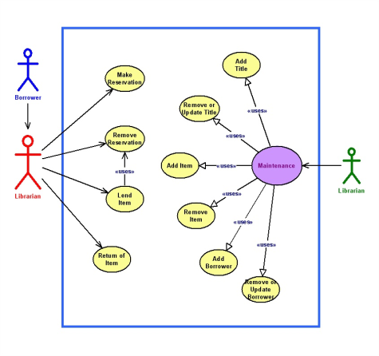
Use Case Example

Slide 69

Example Use Case for ATM
Transfer Money
Use cases : Shown as circles or ovals
Withdraw Money
Check Balance
Client

Slide 70
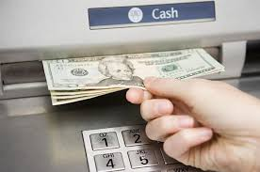
Use Case Name: Withdraw Funds (1)
Summary : Customer uses a valid card to withdraw funds from a valid bank account
Actor : ATM Customer
Precondition : ATM is displaying the idle welcome message
Description :
Customer inserts an ATM Card into the ATM Card Reader
If the system can recognize the card, it reads the card number
System prompts the customer for a PIN
Customer enters PIN

Slide 71

Use Case Name: Withdraw Funds (2)
System checks the card’s expiration date and whether the card has been stolen or lost
If the card is valid, the system checks if the entered PIN matches the card PIN
If the PINs match, the system finds out what accounts the card can access
System displays customer accounts and prompts the customer to choose a type of transaction

Slide 72

Use Case Name : Withdraw Funds
The previous eight steps are part of all three use cases
The following steps are unique to the Withdraw Funds use case
Customer selects Withdraw Funds, selects the account number, and enters the amount
System checks that the account is valid, makes sure that customer has enough funds in the account, makes sure that the daily limit has not been exceeded, and checks that the ATM has enough funds
If all four checks are successful, the system dispenses the cash
System prints a receipt with a transaction number, the transaction type, the amount withdrawn, and the new account balance
System ejects card
System displays the idle welcome message

Slide 73

Use Case Name: Withdraw Funds (1)
Alternatives :
If the system cannot recognize the card, it is ejected and the welcome message is displayed
If the current date is past the card's expiration date, the card is confiscated and the welcome message is displayed
If the card has been reported lost or stolen – stolen, it is confiscated and the welcome message is displayed
If the customer entered PIN does not match the PIN for the card, the system prompts for a new PIN
If the customer enters an incorrect PIN three times, the card is confiscated and the welcome message is displayed

Slide 74

Use Case Name: Withdraw Funds (2)
More alternatives:
If the account number entered by the user is invalid, the system displays an error message, ejects the card and the welcome message is displayed
If the request for withdraw exceeds the maximum allowable daily withdrawal amount, the system displays an apology message, ejects the card and the welcome message is displayed
If the request for withdraw exceeds the amount of funds in the ATM, the system displays an apology message, ejects the card and the welcome message is displayed
If the customer enters Cancel, the system cancels the transaction, ejects the card and the welcome message is displayed
Post condition :
Funds have been withdrawn from the customer’s account

Slide 75

Use Case Extended Relationships
One can use an extend relationship to specify that one use case (extension) extends the behavior of another use case (base)
One can add extend relationships to a model to show the following situations
A part of a use case that is optional system behavior
A sub-flow is executed only under certain conditions

Slide 76

Sample Graphical Use Cases
Each oval is a use case
See Modeling Example

Slide 77

Sample Graphical Use Case
See Modeling Example for placing an on-line order

Slide 78


User Stories versus Use Cases
A User Story is the prelude to the use case by stating the need before the use case tells the story

Slide 79

Activity Diagrams
Activity diagrams are graphical representations of workflows
Intended to model both computational and organizational processes
Shows the overall flow of control

Slide 80

Activity Diagrams (1)
Activity diagrams are constructed from a limited number of shapes, connected with arrows (like a flowchart)
Rounded rectangles represent actions
Diamonds represent decisions
Bars represent the start (split) or end (join) of concurrent activities

Slide 81

Activity Diagrams (2)
A black circle represents the start (initial state) of the workflow
An encircled black circle represents the end (final state)
Arrows run from the start towards the end and represent the order in which activities happen

Slide 82

Use Cases to Activity Diagrams
Use case descriptions become action state nodes in the activity diagram
Alternatives are sequential branch nodes

